Slide 1

Taxonomy
2nd Year – 1st semester
Dr. Munira Ch. Ismail

Slide 2
Components of taxonomy:
Nomenclature:
Assignment of names for purposes of communication and identification
Use a binomial systems of nomenclature.
Classification:
Ordering organisms with like characteristics into groups or taxa (singular - taxon)
Based on established procedures and rules.
Describes groups of organisms, their interrelationships and boundaries between groups.
Identification:
Application of classification & nomenclature to assign proper name to unknown
organism and place it in its proper position within classification system.

Slide 3
Scientific Nomenclature:
Carolus Linnaeus
Binomial nomenclature: genus + species
– italicized or underlined.
– genus is capitalized
– specific epithet (species) is lower case.
“Latinized”
-used worldwide

Slide 4
Scientific nomenclature
Naming bacteria
– Names can describe characteristics or honor pioneer in field
– Rules established by International Committee= Bacteriological on Systemic Bacteriology.
-Code
Bergey’s Manual contains description and rules
Compiled from publications in International Journal of Systemic Bacteriology
Change as new techniques disclose similarities and differences.

Slide 5
Examples:
Staphylococcus aureus
– Describes the clustere darrangement of the cells (staphylo-) and the golden color of the colonies (aur-).
Escherichia coli
– Honors the discoverer, Theodor Escherich, and describes the bacterium’s habitat–the large intestine or colon.
After first use, can be abbreviated as:
“S. aureus” and “E. coli”

Slide 6
1) Phenetic Classification:
Classification according to phenotypic characteristics
Group analogously similar organisms
Phenetic Classification Parameters:
Morphology:
cell shape and size, arrangement of cells, arrangement of flagella, capsule, andospores,mechanism of motility
staining properties – e.g., Gram stain reaction and acid-fast stain reaction.

Slide 7
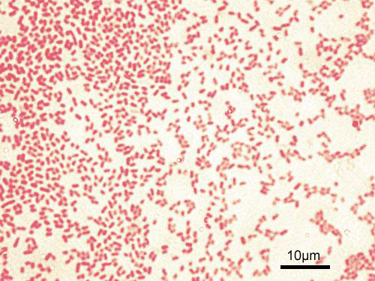

Gram negative bacteria. Gram positive bacteria.
Pseudomonas aeroginosa. Staphylococcus aureus.

Slide 8
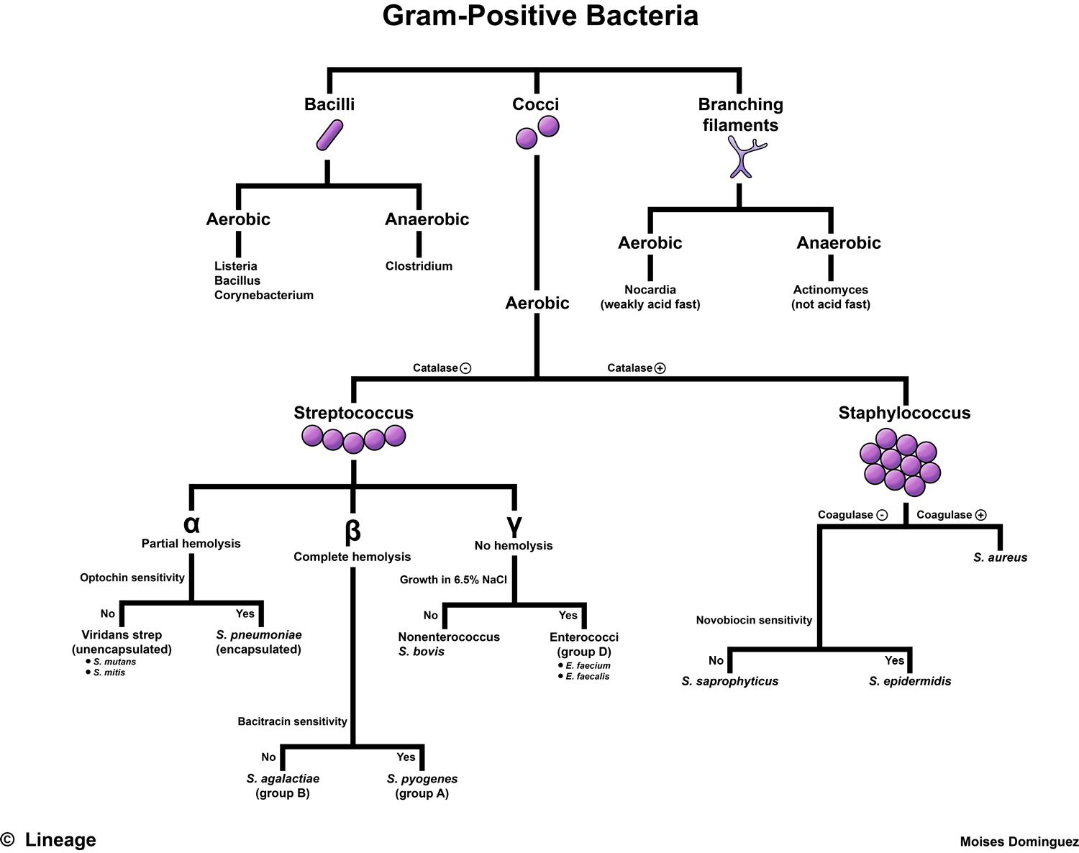

Slide 9
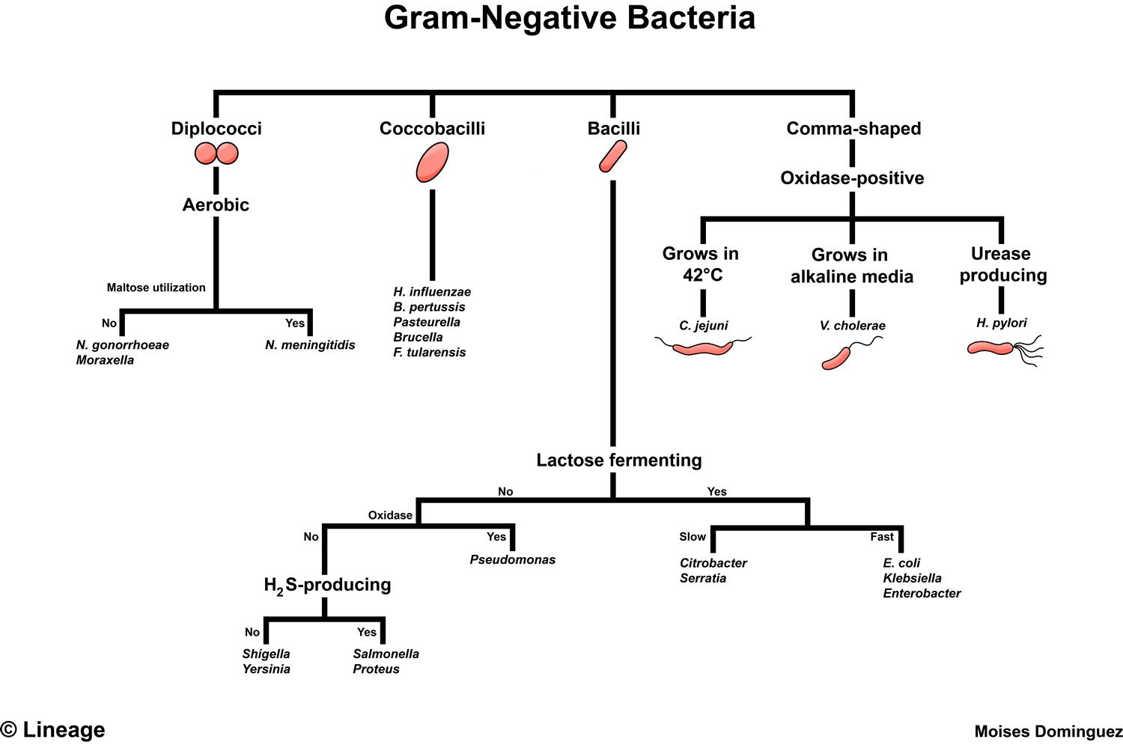

Slide 10
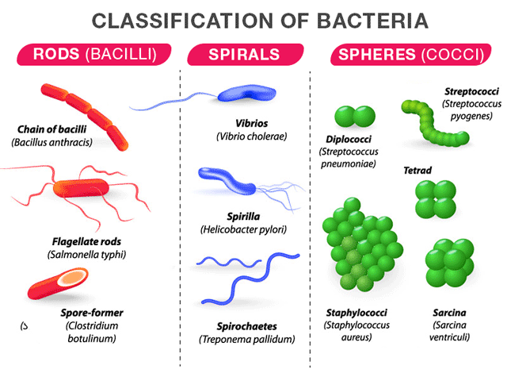

Slide 11
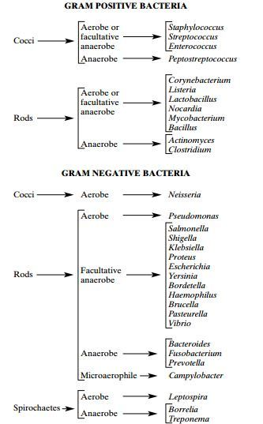

Slide 12
b. Nutrition and physiology:
Modes of metabolism (phototroph, chemoorganotroph, chemolithotroph); energy sources carbon, nitrogen and sulfur sources, fermentation products, growth factor requirements;
Temperature range and optima, pH tolerance range, osmotic tolerance, salt
requirements and tolerance, secondary metabolites formed, storage inclusions…
Many different biochemical tests are used to assess a microbes nutrition and physiology.
c.Serotyping
Identifying a microorganism based on its reaction to particular antibodies.
The antibodies are used to identify microorganisms carrying particular antigens. Techniques likethe Western blot or Enzyme Linked Immunosorbent Assay (ELISA).

Slide 13
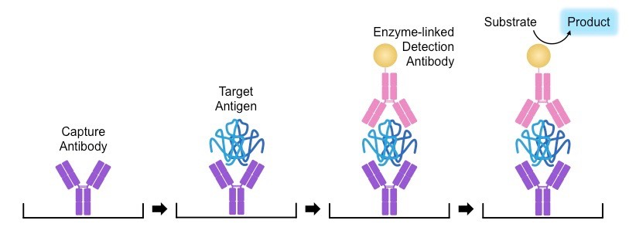
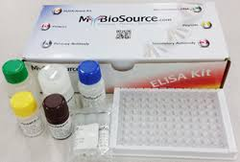
Principle of ELISA TEST
ELISA KIT

Slide 14
d• Phage typing – determines the susceptibility of a bacterium to a particular phage type.
Bacteriophages (viruses that infect bacteria) have very specific hosts and can be use to ID bacteria. (Highly specialized).
Phagetyping Plate

Slide 15
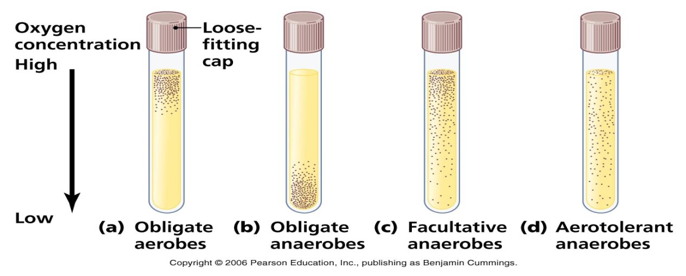
e. Ecological Characteristics:
The ability of a microorganism to colonize a particular environment.
Life cycle patterns, the nature of symbiotic relationships, the ability to cause disease in a particular host, habitat preferences (e.g., requirements for temperature, pH, oxygen, osmotic concentration).
effect of oxygen on bacterial growth

Slide 16
f. Genetic analysis
– the study of chromosomal gene exchange through transformation, conjugation and transduction is sometimes useful for classification
Application of Phenotypes in Taxonomy and Systematics:
Development of diagnostic keys for identification(e.g. Dichotomous key in Microbiology lab manual).
Many commercial systems have been developed for microbial identification
API – biochemical test profiling – often carbon source use but may also include enzymati cactivities and other attributes.(The API strips are designed for the identification of bacteria).

Slide 17
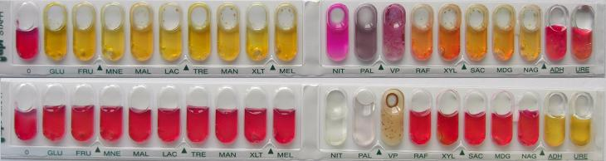
Api 20 strip

Slide 18
Enterotube – biochemical test profiling.
Biolog – tests usage of 95 different carbon sources and compares results to a database of characterized bacteria.
FAME – fatty acid methyl ester – this techniques determines the cellular fatty acid profileand compares it to a database of characterized bacteria.

Slide 19
2) Phylogenetic:
a)Nucleic acid base composition:
G + C content = the percent of G + C in the DNA
Can be determined by hydrolysis of DNA and HPLC analysis of the resulting bases or by melting temperature (Tm) determination.
Organisms with that differ in their G + C content by more than 10% are likely to have quite different base sequences.

Slide 20
b)DNA:DNA hybridization
genomic DNA from one organisms is labeled and hybridized with the genomic DNA from another organism. This technique measures the similarity between the two DNAs. Does not work well for comparing distantly related microorganisms
DNA chip technology has made it possible to “print” many different species specific probes(> 10,000) onto a glass slide (i.e., the “chip”). Genomic DNA is extracted from an unknown organism and labeled with a fluorochrome. The labeled genomic DNA is hybridized with the probes on the chip. Hybridization reactions fluoresce and can be identified by reading the DNA chip with an instrument known as a DNA chip reader.

Slide 21
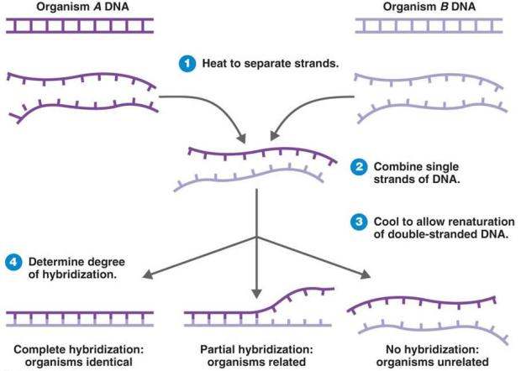

Slide 22
c) Ribosomal RNA sequence analysis – rRNA genes
(i.e., rDNA) from an unknown is isolated, sequenced and compared to database entries. The rDNA can easily be isolated by using rDNA specific primers and PCR. The amplified rDNA gene fragments are sequenced and compared to database entries (e.g., GenBank or Ribosomal Database project).

Slide 23
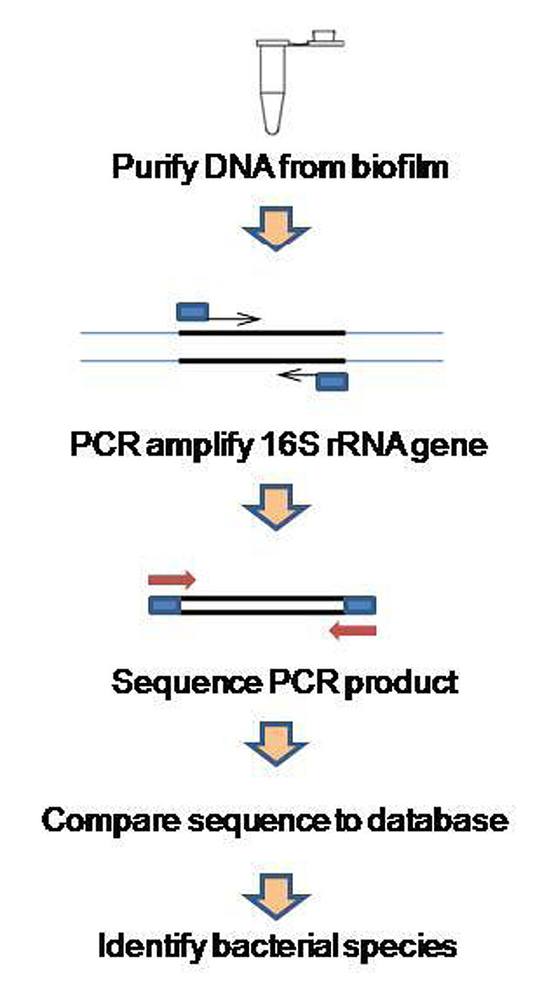

Slide 24
d) Ribotyping
a technique used for bacterial identification.
Genomic DNA is digested with restriction enzymes and then probed with an rRNA probe.
Banding pattern is compared to a database
This technique is also known as molecular fingerprinting because a unique banding pattern appears for virtually any organism.

Slide 25
e) Multilocus Sequence Typing (MLST).
This technique involves the sequencing fragments from 6 to 7 genes (often house keeping genes) from an organism and comparing these with the same gene set from different strains of the same organism.
Can distinguish between closely related strains.
While rRNA gene sequence analysis is capable of identifying organisms to the genus level, MLST is useful for identifying organisms to the species level and below. MLST is not useful above the species level because is it too sensitive.
This technique has been used in epidemiological studies to track virulent strains of bacteria as well as differentiating strains of a particular pathogen heterotrophs .

Slide 26
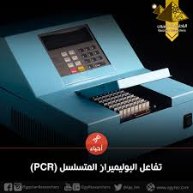

Slide 27


